Slide 1
Photo Filter Using Python
A simple image filter with interactive GUI and incredible features!
122101019 KIRAN M V

Slide 2
Introduction
The aim of the project is to create a photo/image filter using Python.
The project involves adjusting brightness, contrast, adding blur, and detecting the edges of an image.
A Graphical User Interface (GUI) is also added to select the filter and display the effects on the image.
Expected result:
A functional application that allows the user to manipulate images using various filters and to save the filtered images.

Slide 3
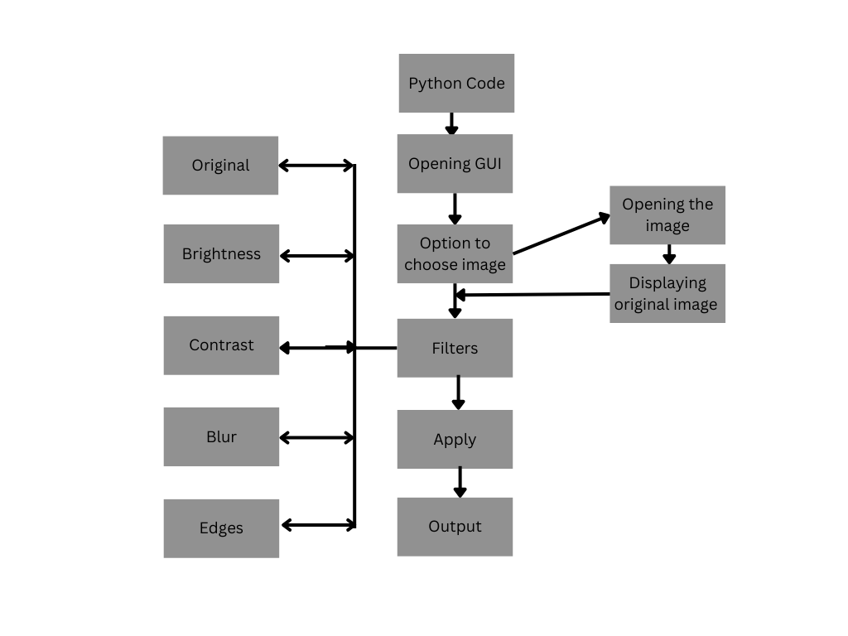
Flowchart

Slide 4
Tools Used
The project uses the OpenCV and Pillow libraries for image processing, Numpy for computation and Tkinter for GUI development.
OpenCV is a library of programming functions used for real-time computer vision and image processing.
Pillow is a free and open-source additional library that adds support for opening, manipulating, and saving many different image file formats.
Numpy is used to perform a wide variety of mathematical operations on arrays.
Tkinter is a standard GUI library for Python. Tkinter provides a powerful object-oriented interface to the Tk GUI toolkit.

Slide 5
Tools Used
Open CV: For image processing methods like Gaussian Blur,Canny,etc
Pillow: For opening image and manipulating the format of the image
Numpy: Computation of array in Brightness mode
Tkniter: For GUI

Slide 6

Challenges faced
TclError: no display name and no $DISPLAY environment variable
Reason: There is an environment variable missing inside the script. If the variable is not missing, it does not have an assigned value attached to it.
Solution: Add a display variable(automatically added in VS code)
Difficulty in opening the Image

Slide 7
THANK YOU

